Slide 1

ICT Learning Centre @ UL - Python and ML Foundations
Python - Loops

Slide 2


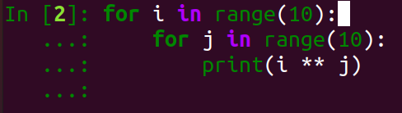
Loops
Don’t Repeat Yourself (D.R.Y)

Slide 3

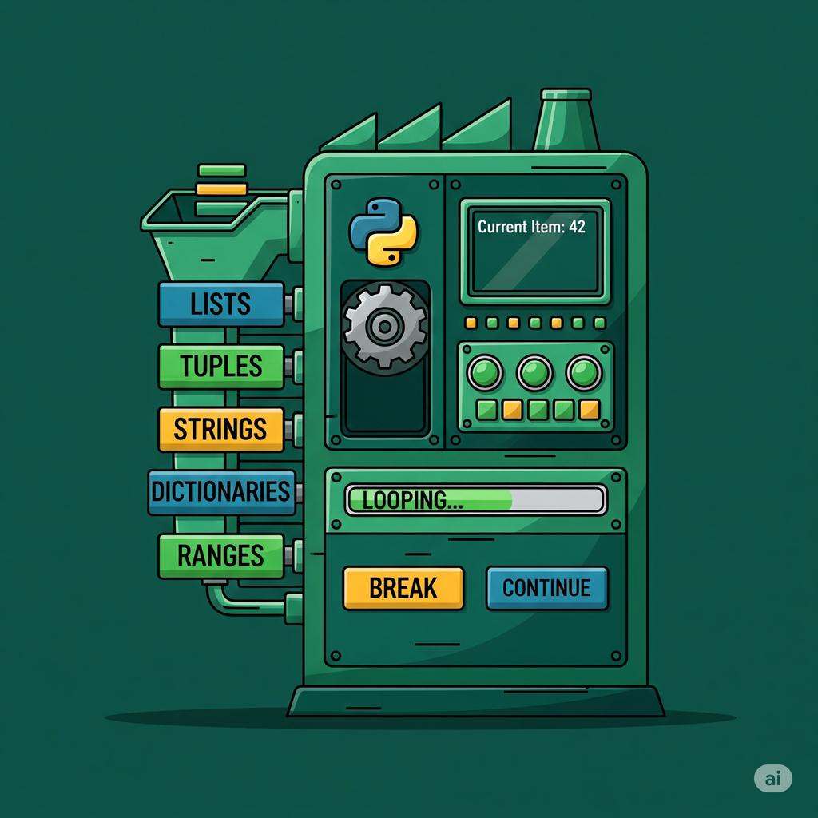
What are loops?
Executes blocks of code for a defined number of iterations.

Slide 4
Why use loops?
Reduces duplicate code and logic.
Helps readability.

Slide 5
How to implement loops in Python?
Loops in Python
For Loops
While Loops

Slide 6
For loops in Python: Syntax
for <VARIABLE> in <ITERABLE>:
# Do something
# End of loop

Slide 7
For loops in Python: Syntax
for <VARIABLE> in <ITERABLE>:
# Do something
# End of loop

Slide 8
For loops in Python: Syntax
for <VARIABLE> in <ITERABLE>:
# Do something
# End of loop

Slide 9
For loops in Python: Syntax
for <VARIABLE> in <ITERABLE>:
# Do something
# End of loop

Slide 10
For loops in Python: Example
installed_software = [‘python’, ‘git’, ‘docker’]
for software in installed_software:
print(software)

Slide 12
For loops in Python: using range()
installed_software = ["python", "git", "docker"]
for i in range(10):
print(i,“ x 7 = ”, i*7)

Slide 13
For loops in Python: using range()
installed_software = ["python", "git", "docker"]
for i in range(1, 10, 2):
print(i,“ x 7 = ”, i*7)

Slide 14




Step Parameter
my_list[start:end:step]

Slide 15


Step Parameter
my_list[start:end:step]
1
2
3
4
5
6
7
8
9
10
numbers[ : :2] →

Slide 16

Step Parameter
my_list[start:end:step]
1
2
3
4
5
6
7
8
9
10
numbers[ : :2] →

Slide 17
Step Parameter
my_list[start:end:step]
1
2
3
4
5
6
7
8
9
10
1
3
0
1
2
3
5
4
5
6
7
8
9
numbers[ : :2] →

Slide 18
Step Parameter
my_list[start:end:step]
1
2
3
4
5
6
7
8
9
10
0
1
2
3
4
5
6
7
8
9
numbers[ : :2] →
1
3
5
.....

Slide 19
For loops in Python: range()
installed_software = ["python", "git", "docker"]
for i in range(1, 10, 2):
print(i,“ x 7 = ”, i*7)

Slide 20
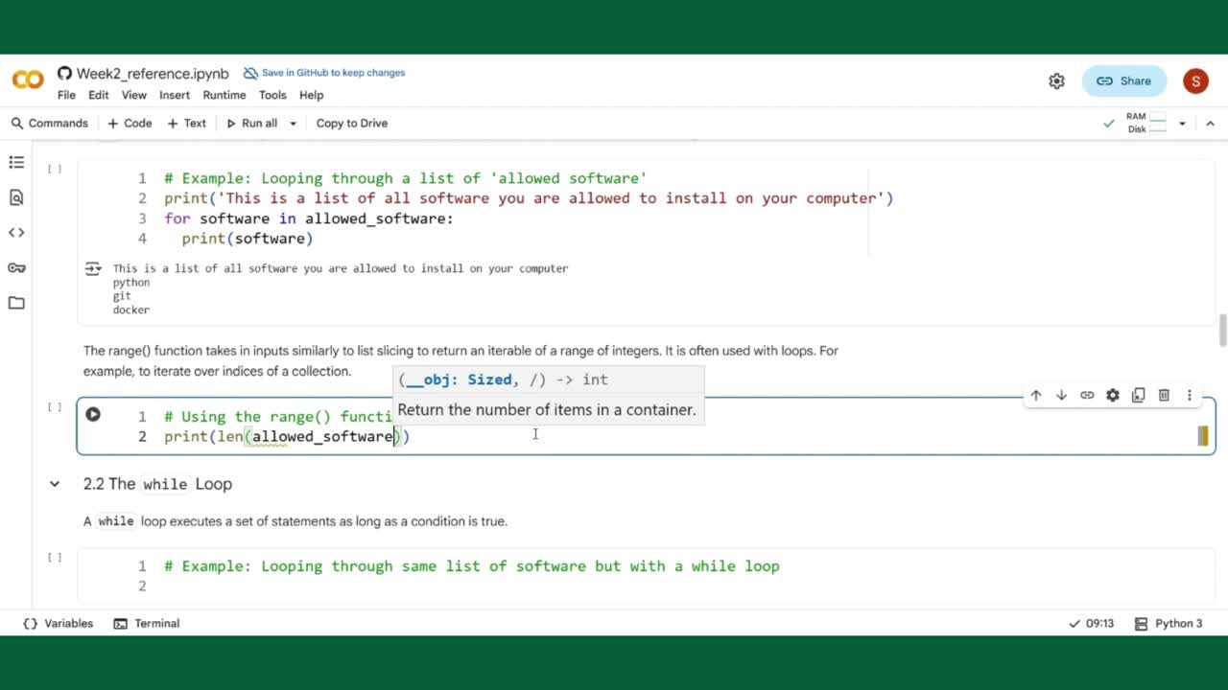

Slide 21
While loops in Python: Syntax
count = 0
# Value depends on logic
while <END_CONDITION>:
# Do something
count += 1 # Important!
# End of loop
Will result in infinite loop otherwise.

Slide 22
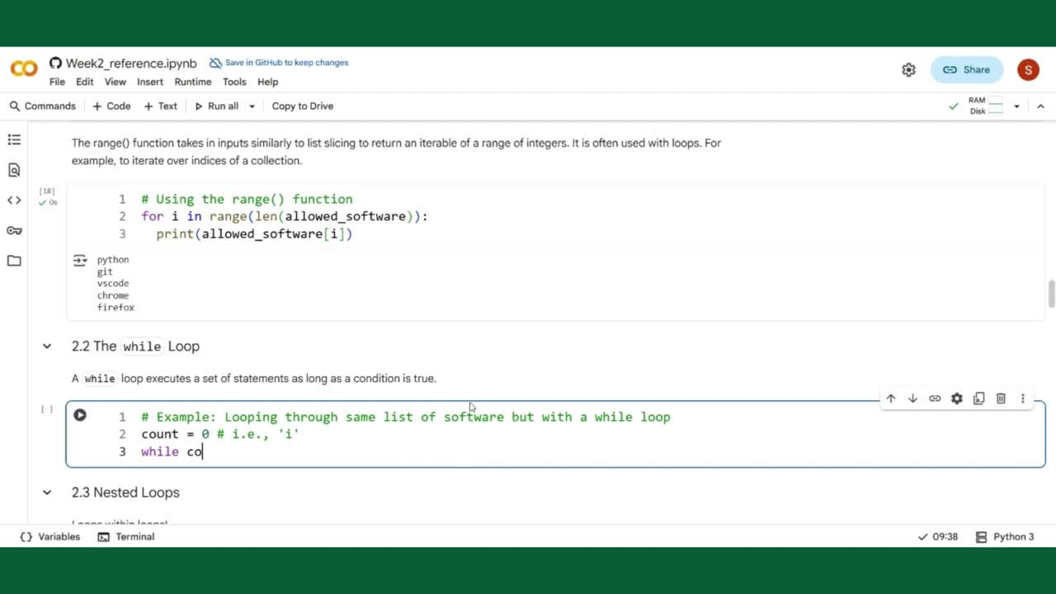

Slide 23
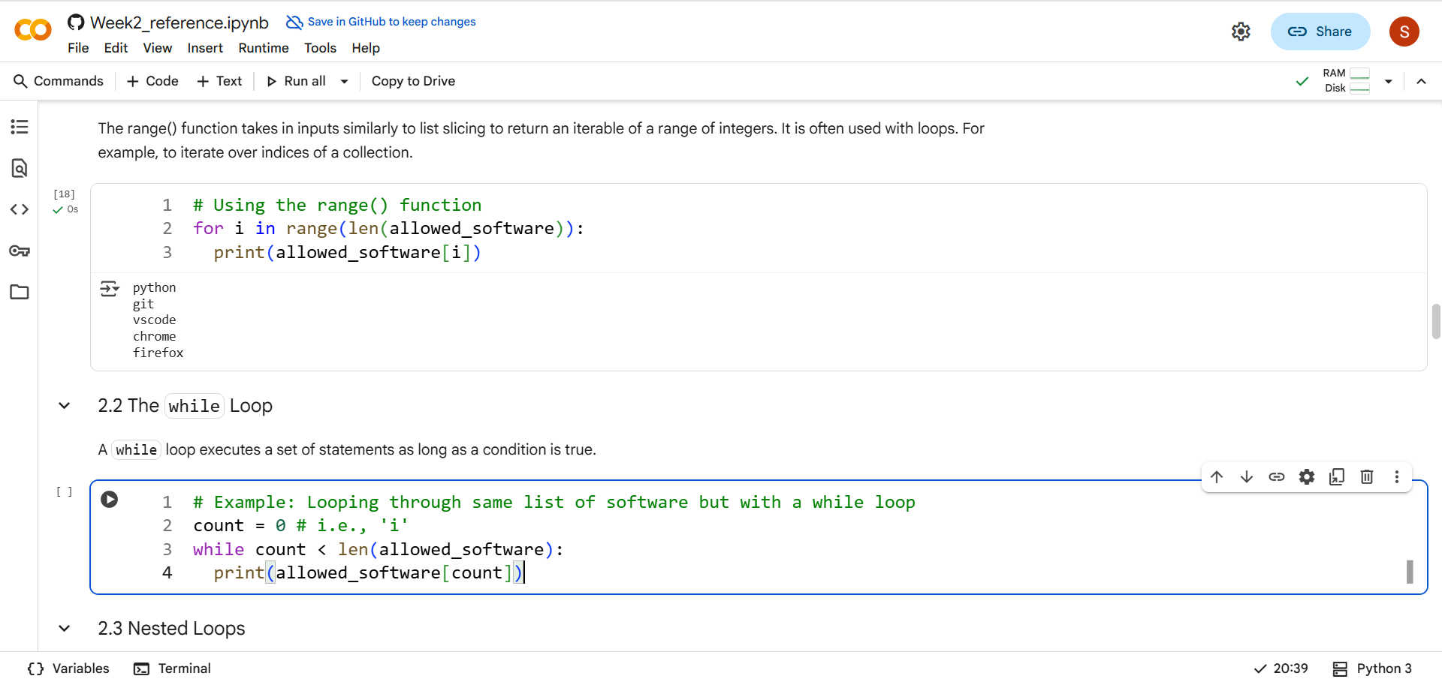

Slide 25
While loops in Python: Example
installed_software = ["python", "git", "docker"]
count = 0
while count < len(installed_software):
print(installed_software[count])
count += 1

Slide 26
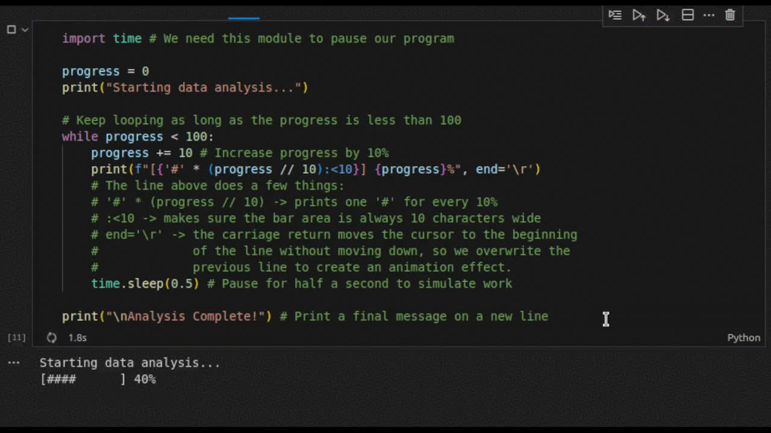
When to use while over for?

Slide 27
Flow control in loops
break
Exits the loop during execution.
continue
Skips code below and goes to next iteration.
'
else
Code block that runs if a loop finishes normally i.e., no break.

Slide 28
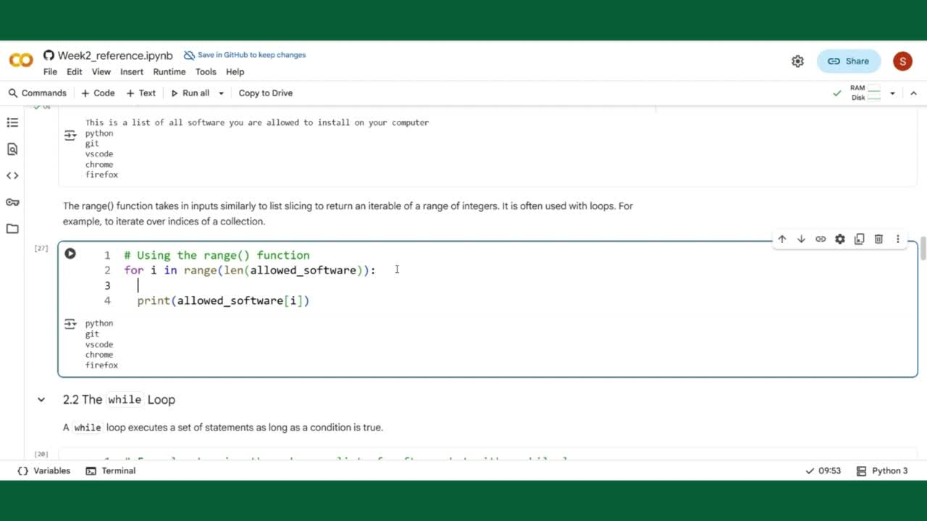

Slide 29
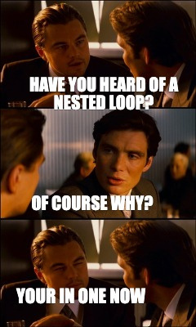
Nested loops: What?

Slide 30
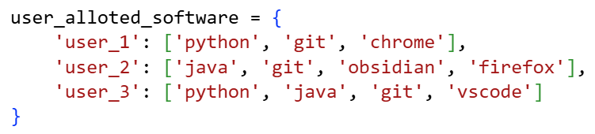
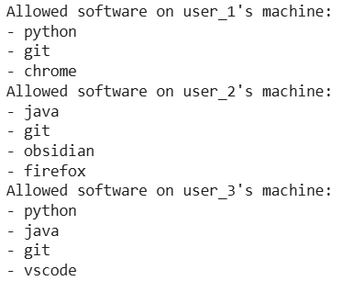
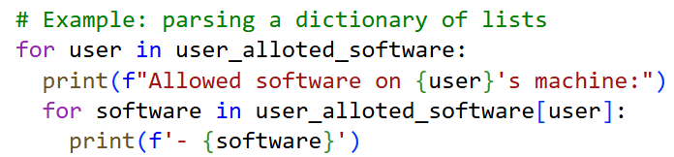
Nested loops: Example
Output:

Slide 31
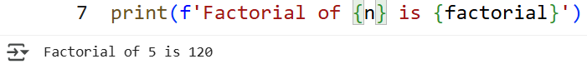
Practice Question
Create a loop that calculates the factorial of the number 5. A factorial is the product of all positive integers up to that number (e.g., 5! = 5 * 4 * 3 * 2 * 1).
Expected output

Slide 32

ICT Learning Centre,
CS1-046,
CSIS Building,
University of Limerick,
http://ictlc.ul.ie/contactus
Thank you

